Slide 1
Quantum Storytelling and Ensemble Leadership
David M. Boje
October 7, 2018

Slide 2
Since gender inequality constitutes one of the history’s most persistent and widespread forms of injustice, eliminating it will call for one of history’s biggest movements for change. Women and girls continue to suffer discrimination and violence in every part of the world.

Slide 4
Ecofeminism is 3rd wave Feminism
Ecofeminism is inquiry into the system of capitalist patriarchy that is the underlying source of both the exploitation of nature and the oppression of women

Slide 5
What gets Measured Gets done
Goal 5. Achieve gender equality and empower all women and girls
5.1 End all forms of discrimination against all women and girls everywhere
5.2 Eliminate all forms of violence against all women and girls in the public and private spheres, including trafficking and sexual and other types of exploitation
5.3 Eliminate all harmful practices, such as child, early and forced marriage and female genital mutilation
5.4 Recognize and value unpaid care and domestic work through the provision of public services, infrastructure and social protection policies and the promotion of shared responsibility within the household and the family as nationally appropriate
5.5 Ensure women’s full and effective participation and equal opportunities for leadership at all levels of decision- making in political, economic and public life
5.6 Ensure universal access to sexual and reproductive health and reproductive rights as agreed in accordance with the Programme of Action of the International Conference on Population and Development and the Beijing Platform for Action and the outcome documents of their review conferences
UN SOURCE
QUESTION: ARE THESE MEASURES PERPETUATING a LIBERAL ECOFEMINISM OF GENDER EUALITY WHILE IGNORING THE HIDDEN CURICULUM? Answer: they are 2nd wave liberal feminism, not 3rd wave ecofeminism

Slide 6
Ecofeminism as Politics
Gets at the Embodied Materialism practices of Carboniferous capitalism that prevent or subvert Gender Equality UN GOAL #5
UN GOAL 5 is not MEASURING the embodied roots of capitalist patriarchal globalization & multinational carbon corporate influence on UN that prevents the 2030 goal realization
Ecofeminism as Politics: Nature, Marx, and the Postmodern 2nd Edition
by Ariel Salleh (Author), Vandana Shiva (Foreword)

Slide 7
What is Embodied Materialism?
Aerial Salleh’s concept of “embodied ecofeminist materialism,” moves “to interrogate the euro-centric convention that positions Man over and above Woman and Nature in Capitalism
Embodied Materialism Ecofeminism then turns to how to reconnect men and women with ecological time — materially and discursively in an Ecocentric instead of Humancentric praxis of new capitalism

Slide 8
THE NEW WORLDVIEW: NON-HIERARCHY
QUANTUM STORYTELLING and ENSEMBLE LEADERSHIP

Slide 9
Critique of Aristotle’s Patriarchal Hierarchy

Slide 10
Nietzsche was Against Gender Equality
“Women are all skilful in exaggerating their weaknesses, indeed they are inventive in weaknesses, so as to seem quite fragile ornaments to which even a grain of dust does harm,” Nietzsche, The Gay Science.
“Women are manipulative, dangerous creatures who only feign weakness in order to beguile man and “defend themselves against the strong and the ‘law of the jungle.'”
“Woman’s love involves injustice and blindness against everything that she does not love…Woman is not yet capable of friendship: women are still cats and birds. Or at best cows…,” he writes in Thus Spoke Zarathustra.
“Everything in woman is a riddle, and everything in woman has one solution—that is pregnancy. For the woman, the man is a means: the end is always the child.”

Slide 11
Yet, Nietzsche was pro-Nature
Feminist Interpretations of Friedrich Nietzsche, Kelly Oliver and Marilyn Pearsall explain why a feminist would read Nietzsche in the first place:
He displays his misogyny directly
He has ironic treatment of ‘eternal feminine’
http://sarahshugars.com/2015/12/feminism-and-nietzsche/
How can Nietzsche's philosophy contribute to feminist thought? By Sharare Sharoki
Nietzsche attacks the culture/nature dualism and the mind/body dualism. He has an emphasis on embodiment important to feminist philosophy

Slide 12
Quantum Storytelling ➔ Will to Power & Quantum Storytellin
Energy and evolution is at the crux of it all
The goal of Quantum Storytelling is “life” “the same quantum of energy means different things at different stages of evolution” (Nietzsche, WTP # 639).
Will to power, the energy “regarding economically, it rises to a high point and sinks down again in an eternal circle” of “will to power” of the forces of life” (Nietzsche, WTP # 639).

Slide 13
Quantum Storytelling
Quantum Storytelling is defined as one quantum commanding force and a resisting force of energy.
Quantum Storytelling is defined as “Multiplicity of forces” in a struggle we call “life” ” (Nietzsche, WTP # 641).
We use the commanding force of fossil fuel economy to lay foundation for the resisting force, solar economy

Slide 14
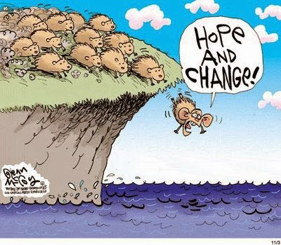
Nietzsche wrote against the herd instinct

Slide 15
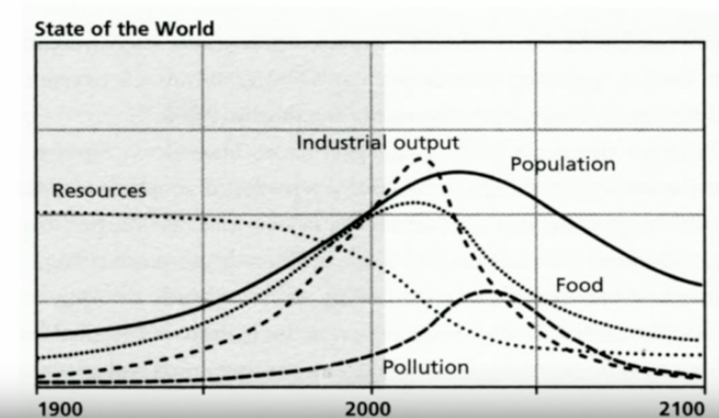
YouTube THE STORY OF MORE by Richard Heinberg
THE TRANSITION in Quantum Storytelling
In last 200 years, fossil fuel revolution transformed energy sources of industrial capitalism, to make MORE STUFF

Slide 16
Quantum Storytelling in 1970s
Will to Power from Fossil Fuel cannot go on forever (The Limits to Growth, 1972: 7): “Achieving a self-imposed limitation to growth would require much effort. It would involve learning to do many things in new ways”
(E.F. Schumpeter, 1973 Small is Beautiful): Growth ➔“The whole point, however, is to give to the idea of growth a qualitative determination; for there are always many things that ought to be growing and many things that ought to be diminishing.”
Make the Ecosystem sacred, declare Mountains and Rivers and Ocean as legal persons

Slide 17
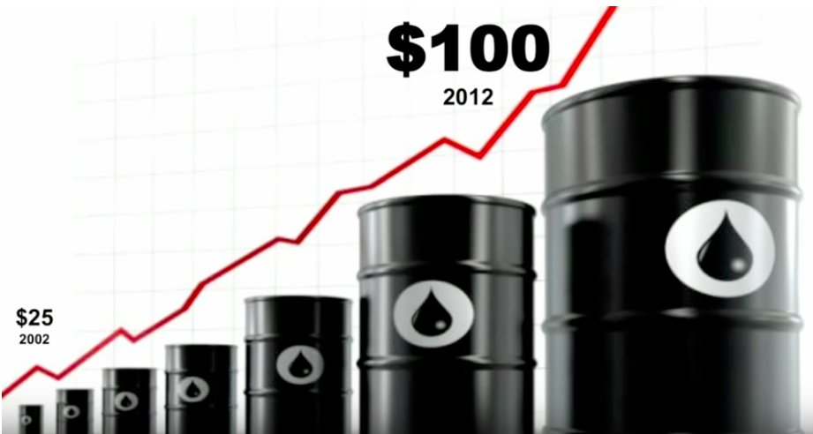
Price of Oil today $75/barrel
Notes:
Oil companies move to tar sands and fracking impermeable rocks to produce shale gas
Consequences of burning oil is melting polar ice cap. The business-as-usual explains the Club of Rome prediction worst case scenario. What makes us happy is quality of the relationships, and continuity of past and present generations. We already have the elements of a new post carbon econy.

Slide 18
Quantum Storytelling in 1970s
Rachael Carson’s 1972 Silent Spring “We spray our elms and the following springs are silent of robin song, not because we sprayed the robins directly but because the poison traveled, step by step, through the now familiar elm leaf-earthworm-robin cycle”
Carboniferous Capitalism ➔ “We have seen that they now contaminate soil, water, and food, that they have the power to make our streams fishless and our gardens and woodlands silent and birdless” (Carson, 1972).

Slide 19
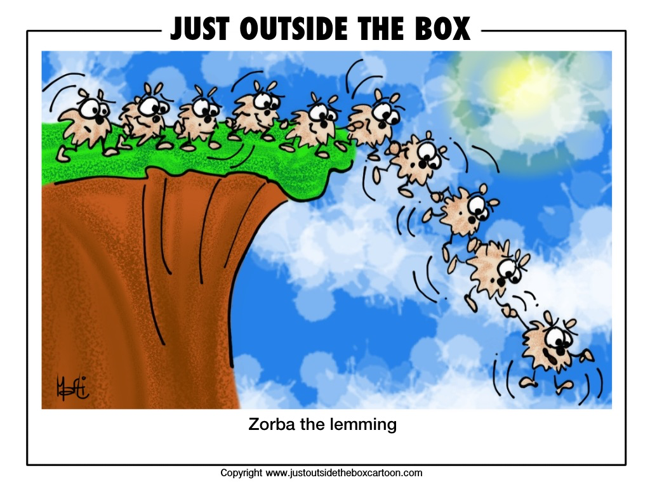

Slide 20
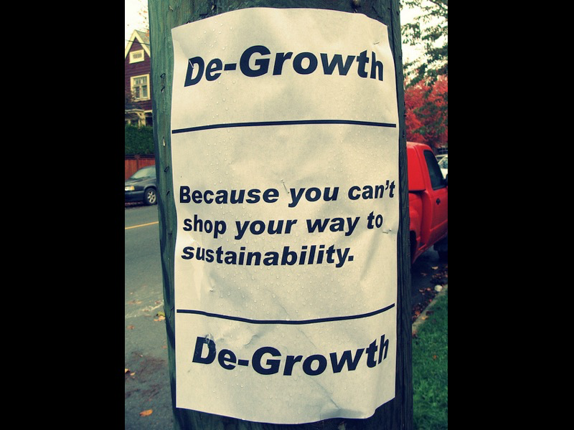
We are already
de-growing
Growth Scenarios are Unrealistic because EROI is decreasing each year
It costs more to get the energy than the energy it generates
Schumacher (1973) SMALL IS BEAUTIFUL
SIMPLIFY
MINIMALIZE
RETHINKING GROWTH YOUTUBE
https://www.youtube.com/watch?time_continue=264&v=0MXP2E09dJQ
More at http://rethinkingprosperity.org/solutions-degrowth/

Slide 21
We already have the elements of a new post carbon economy.
Bio-mimicry – refashion industry around the ways of ecology.
Reduce energy consumption
Drive less, walk and bike more
Happiness is from relationships, continuty of one generation to the next
Our Renewable Future Richard Heinberg 2016 YouTube

Slide 22
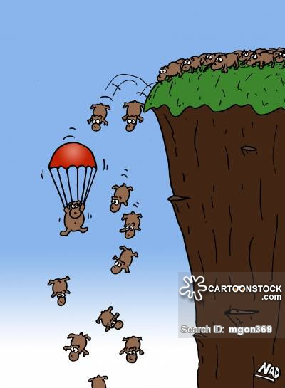
Why be a follower when we can all be Ensemble Leaders?

Slide 23
Quantum Storytelling Multiplicities
Gilles Deleuze theorizes 3 multiplicities
Extensive multiplicities that extend spatially around the globe by different wills to power
Intensive multiplicities that change temporally from one time to the next changing the game of will to power
Virtual multiplicities of (narrative) illusion, denial, delusion that deny the reality of spatial and temporal multiplicities; An untrue storytelling of wills to power.

Slide 24
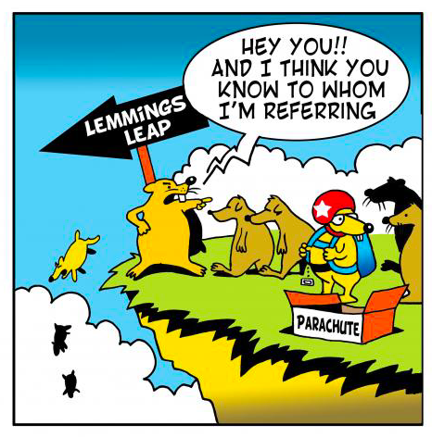
A New Quantum Storytelling Resistance to Command

Slide 25
Quantum Storytelling
Quantum storytelling: “The essential thing is that the faction in struggle emerge with different quanta of power” (Nietzsche, WTP # 634).
Two factions are in power struggle, Wal-Mart Capitalism and Farmer’s Market Capitalism, a global capitalism and a local capitalism, a petrochemical capitalism and a post-carbon capitalism, or a “Carboniferous Capitalism” radiation of power (Mumford,1934/2010: 156), and a radiation of power of zero growth capitalism.
Mumford, L. (1934/2010). Technics and civilization. First published 1934, and Foreword by Langdon Winner in 2010 edition. IL: University of Chicago Press.

Slide 26
Energy Returned/Energy Invested (EROEI) Energy Return on Investment (EROI)
It takes energy to generate Energy-ROI (EROI).
AKA➔Energy Returned on Energy Invested (EROEI)
e.g. Energy to find it, pump it, transport it, process it, transport it again, and energy to make all the materials (steel, aluminum, etc.) to make the transport vehicles, energy to feed & clothe the workers, energy to make their clothes, etc.
Energy Return off Investment (EROI) less than 1 means more energy expended getting the energy resource than it can deliver payback.

Slide 27
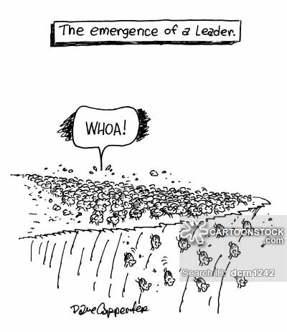
Ensemble Leadership Emerges
Let’s Try Feminist Leadership and get right with Mother Earth

Slide 28
Quantum Storytelling and Ensemble Leadership
“A quantum of power is designated by the effect it produces and that which it resists”(Nietzsche, WTP # 634).
One “radiation of power” resists another radiation of power (Nietzsche, WTP # 634).
For example, I participate In quantum storytelling ensemble of leadership that is the radiation of power of zero growth and resists the growth of “Carboniferous Capitalism” radiation of power (Mumford,1934/2010: 156).
Mumford, L. (1934/2010). Technics and civilization. First published 1934, and Foreword by Langdon Winner in 2010 edition. IL: University of Chicago Press.

Slide 29
Quantum Storytelling
In ensemble leadership we conspire together with others for power-with-others instead of power-over-others (Rosile, Boje & Claw, 2016).
We do ensemble leadership together as we resist “all other dynamic quanta: their essence lies in their relation to all other quanta, in their ‘effect’ upon the same”
(Nietzsche, WTP # 635)

Slide 30
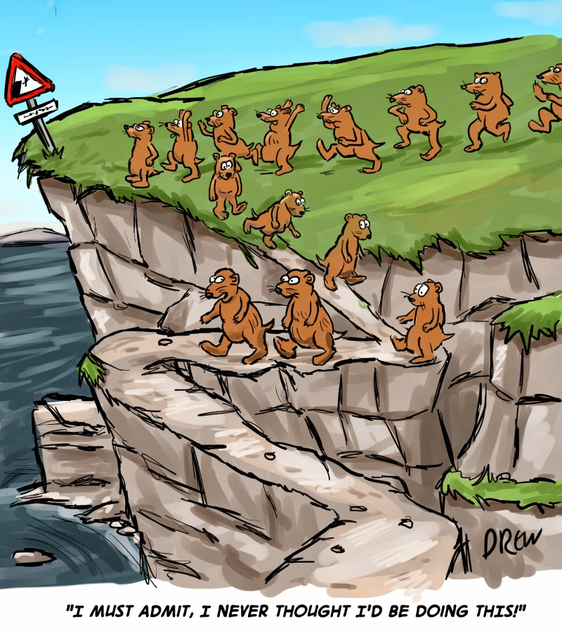
Quantum Storytelling and Ensemble Leadership in a Post-carbon Future

Slide 31
Energy Returned/Energy Invested (EROEI) Energy Return on Investment (EROI)
Energy makes the world go around
Energy is needed to have economies
Energy is need to have cultures
Energy is needed for production, consumption, & distribution of goods and services
Energy surplus creates stability
Energy surplus necessary for health & education
Energy is fundamental to Leadership & Small Business
EROEI & EROI depend upon hidden costs calculations

Slide 32
What is Quantum Storytelling
It is how “every specific body strives to become master over all space and to extend its force ( --- its will to power) and to thrust back all that resists its extension. But it continually encounters similar efforts on the part of other bodies and ends by coming at an arrangement (‘union’) with thos of them that are sufficiently related to it: this they then conspire together for power. And the process goes on---” (Nietzsche, Will To Power, #636).

Slide 33
What is the Will To Power of Ensemble Leadership?
“The will to power not a being, not a becoming, but a pathos---the most elemental fact from which a becoming and effecting first emerge---” (Nietzsche, WTP # 635).
Here a pathos is defined as arousing feelings of healthy-ness, happy-ness, and terrific-ness.

Slide 34
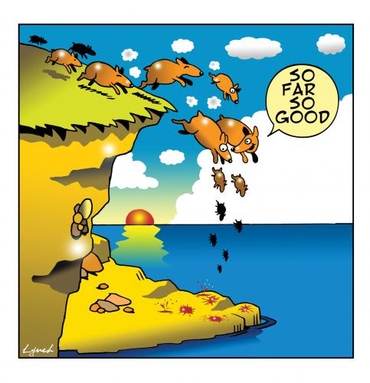

Slide 35
Feminist Leadership & Small Business DeGrowth names an alternative Future
A feminist economy seeks to restore the legitimate rights of communities to these common resources. This autonomy is enabling them to sustain themselves; while evolving more egalitarian systems of governance and use of such resources. A feminist economy acknowledges women’s roles and provides equal opportunities for decision-making, i.e. women as equal claimants to these resources. https://www.awid.org/reclaiming-commons
See Environmental Justice https://www.slideshare.net/environmentalconflicts/02-07martinezalierej-and-degrowth

Slide 36
Quantum Storytelling of Ensemble Leadership
Quantum storytelling is “a sort of shifting and place-changing on the power of a ‘being’ of something constant”, the counter power of the growth of Carboniferous Capitalism and the resistance of Post-Carbon Capitalism (Nietzsche, WTP # 631).
This is a struggle of two capitalism of unequal power right here in Las Cruces New Mexico, in New Mexico State University, in the relation of powerful Wal-Mart and less powerful Farmer’s Market, each with a different measure of power (#633).

Slide 37
Moral Answerability of Ensemble Leadership
I cannot separate my deed from the doer of of the act/deed in my once-occurrent event-ness of Being in this world (Bakhtin, 1993: 2-3; Nietzsche, WTP # 631 ).
I am not a bystander judging old capitalism struggling with a newly emerging capitalism, and doing nothing. This is Bakhtin’s ‘special answerability’ and is not the doer of deeds of the ethics of ‘moral answerability’
Bakhtin, M.M. (1993, written 1919-1921) Toward a Philosophy of the Act.

Slide 38
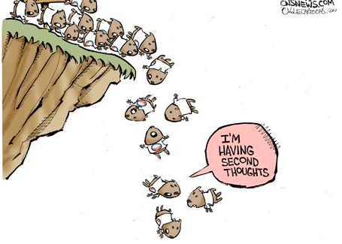

Slide 39
Quantum Storytelling Hope for the Future
As we transition from Fossil Fuel to Solar and Wind Energy, we will evolve a Quantum Storytelling of Simplicity, Minimalism, and Limit the Passion for Growth, while increasing Happiness, Healthiness, and Terrificness.
For more hear the audio Richard Heinberg – Afterburn: Society Behond Fossil Fuels. We ill need to invent a productive financial system instead of current speculative (Casino) finance that brought on the 2008 Wall Street downward spiral of financial crashes globally
Will to Power of Solar resistance will emerge from the Carboniferous will to power of speculation that fuels Planned Obsolescence
We lived without growth by carboniferous until the 1850
Corporations are growth machines: grow or die, at all costs, or replace the leaders. A cooperative is an Ensemble Leadership where growth is not the necessity of its will to power
We can survive the will to growth and have a healthier, happier, and more terrific economy life.

Slide 40
What to do to be Quantum Storyteller?
Put up solar panels and go off-grid
Unplug from Fossil Fuels
Work less, play more in sharing economy
Composting in instead of wasting
Simplify your lifestyle
De-clutter
Minimalization
Substitutes for Plastic
Repair and Reuse instead of single-use
Be resilient in your will to power

